Slide 1
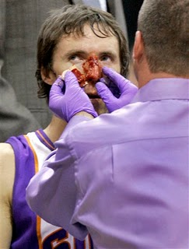
Standard Precautions to Prevent Disease Transmission

Slide 2
Standard Precautions to Prevent Disease Transmission
Introduction
How do we catch a cold or get the flu?

Slide 3
Standard Precautions to Prevent Disease Transmission
Students will be able to:
Identify how disease is spread.
Understand how to prevent disease transmission.
Practice using personal protective equipment to prevent disease transmission.

Slide 4
Standard Precautions to Prevent Disease Transmission
Diseases are spread by:
Direct Contact
Indirect Contact
Airborne Transmission
Vector transmission

Slide 5
Standard Precautions to Prevent Disease Transmission
Direct Contact
By making unprotected Direct Contact with blood or other body fluids.

Slide 6
Standard Precautions to Prevent Disease Transmission
Indirect Contact
When a person touches objects that have been contaminated

Slide 7
Standard Precautions to Prevent Disease Transmission
Airborne Transmission
When a person inhales infected droplets

Slide 8
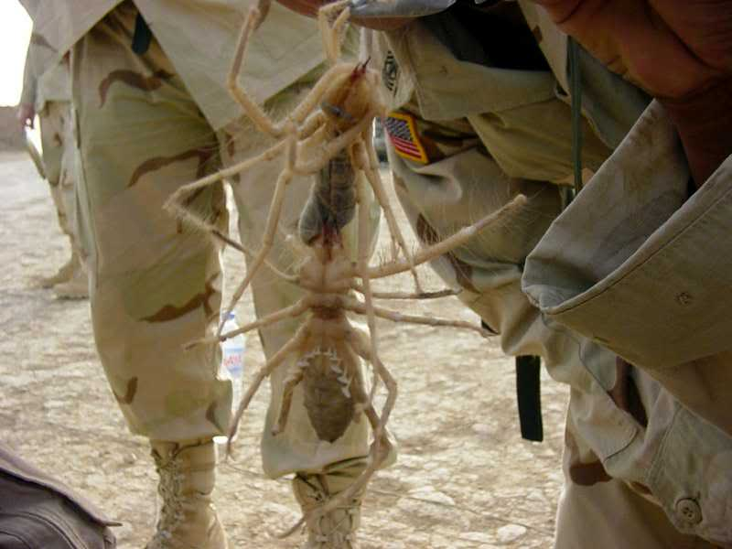
Standard Precautions to Prevent Disease Transmission
Vector Transmission
Occurs through animal or insect bite

Slide 9
Standard Precautions to Prevent Disease Transmission
Avoid contact with blood/bodily fluids no matter the surface

Slide 10
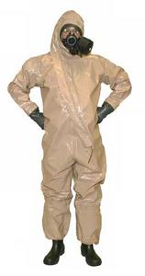
Standard Precautions to Prevent Disease Transmission
Use Personal Protective Equipment or protective barriers when providing care

Slide 11
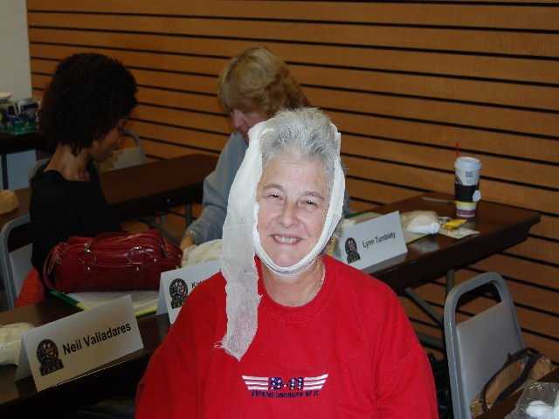
Standard Precautions to Prevent Disease Transmission
Cover open wounds and skin conditions with bandages

Slide 12
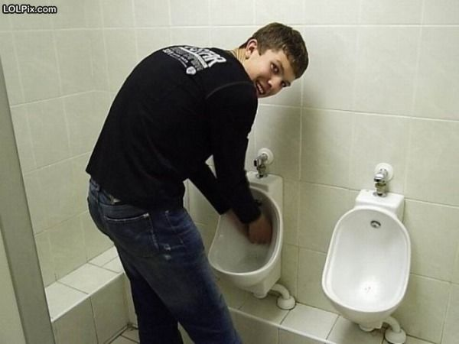
Standard Precautions to Prevent Disease Transmission
Wash hands with soap and water after providing care
Even if you wore gloves

Slide 13
Standard Precautions to Prevent Disease Transmission
Treat all victims as though they are infectious
Don’t eat, drink or touch your face while providing care
Avoid handling personal items (pens, hairbrushes, cell phones, music devices) while providing care
Know where our first aid kit is located and the status of its contents

Slide 14
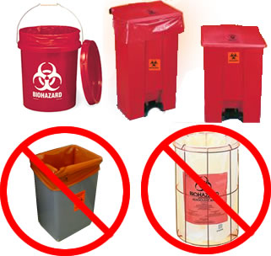
Standard Precautions to Prevent Disease Transmission
Dispose of contaminated material in a biohazard container (or approved workplace container)

Slide 15
Standard Precautions to Prevent Disease Transmission
Think about how much your hands go to your face.

Slide 16
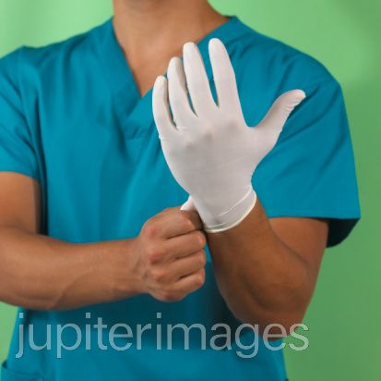
Standard Precautions to Prevent Disease Transmission
Learn how to properly put on and take off protective gloves

Slide 23
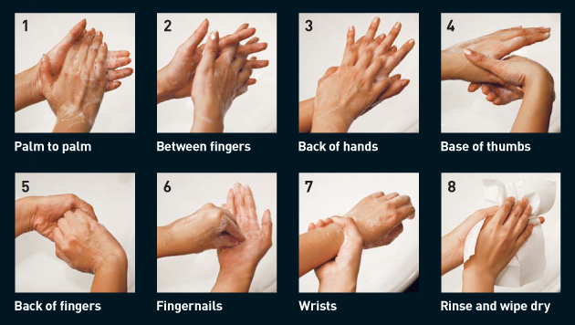
How to prevent!
Hand Washing
Washing WITH soap prevents many infections including HIV!

Slide 24
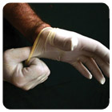
How to prevent…
Gloves
The use of disposal gloves while treating an open wound or the potential exposure to body fluids is a must
Taking off gloves the proper way is just as important as putting them on

Slide 25
How to put on and take off gloves
Remember: the outside of the glove is contaminated!
Grasp outside of glove with opposite gloved hand; Peel off
Hold removed glove in gloved hand
Without touching your wrist, take the opposite glove off
Discard gloves by tying knot and throwing in a waste container
Make sure the glove fits you
Put gloves on by sliding on and securing glove by interlacing fingers for a snug fit
If there is a hole, even at the wrist, throw them away and grab another pair.
Donning Gloves
Doffing Gloves

Slide 26
Other Personal Protective Equipment
What other personal protective equipment is out there for Health Care Workers?

Slide 27
Let’s Practice
We will now practice:
Proper Hand washing
Putting Gloves on
Taking contaminated gloves off

